Slide 1
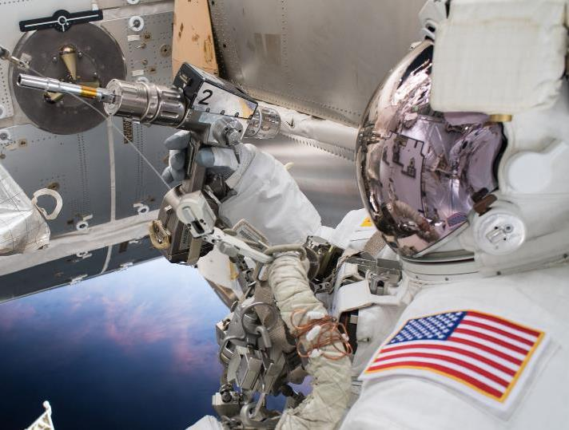
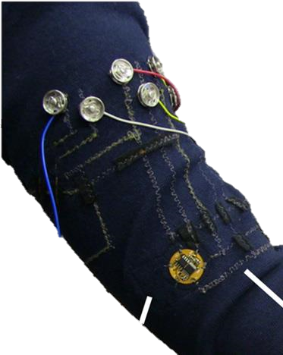
A Wearable EMG Sensing System to Support Robotic Assistance for Astronaut EVAs
Avinash Baskaran, Chad G. Rose

Slide 2
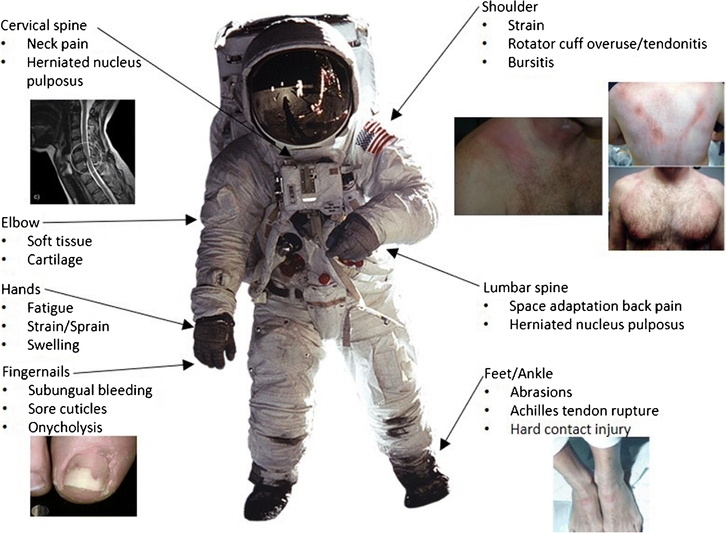
Astronaut EVAs regularly cause discomfort and injury^{[1]}
(figure reproduced from [1])

Slide 3
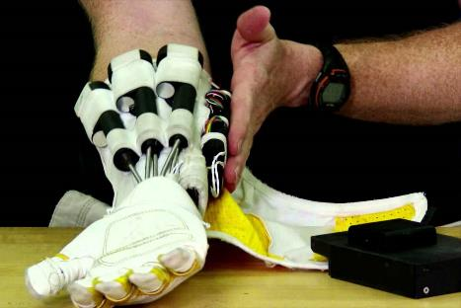
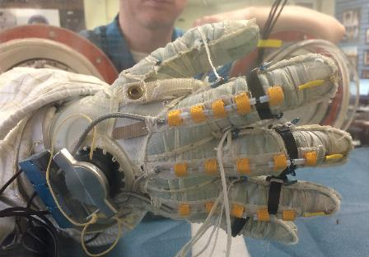
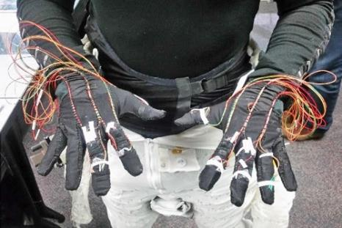
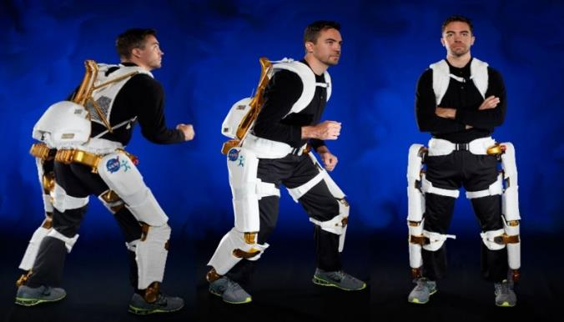
Wearable robots can reduce pain and prevent astronaut injury
Wearable robots can^{[2]}:
Provide assistive loads and torques
Reduce effort to maneuver in spacesuit
Reduce wear and internal damage to spacesuit
Reduce metabolic waste / resource consumption
Enhance movement stability and task success

Slide 4
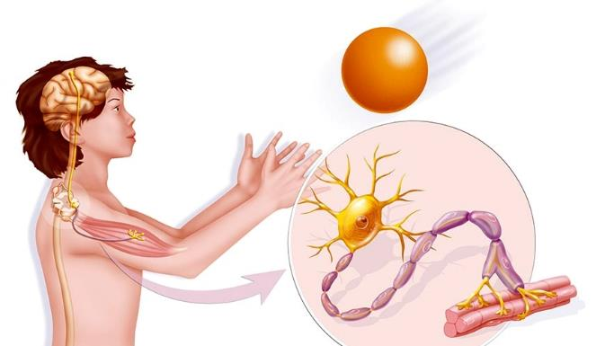
Fatigue modeling is needed for effective robotic EVA assistance
Fatigue effects the entire neuromuscular system, from brain to limbs
Robot control without fatigue modeling less effective in supporting motor performance [4,5]
Inefficient muscle activation
Decreased force production ^{[4,5]}
Fatigue
Diminished proprioception accuracy ^{[4]}
Hindered executive function of motor performance ^{[4]}

Slide 5
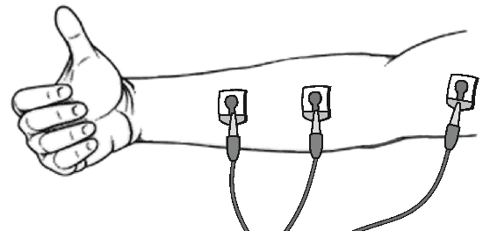
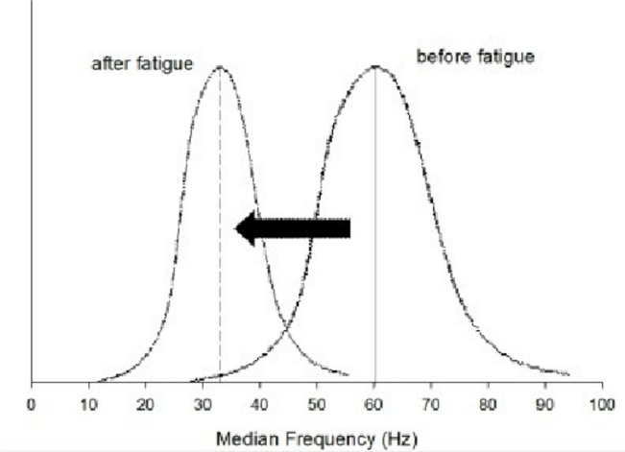
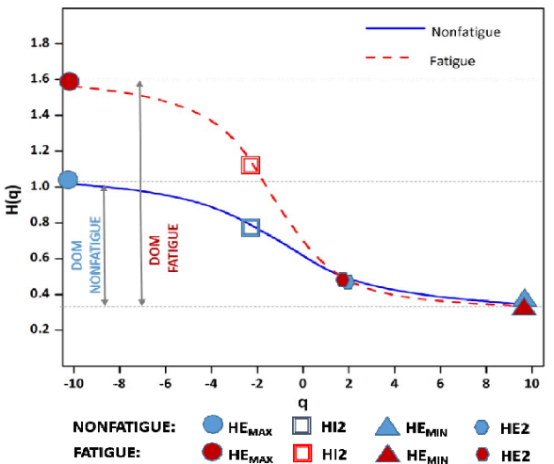
Fatigue is best understood and modeled through Electromyography (EMG) ^{[6]}
EMG electrodes can:
Detect muscle activity from skin surface
Help capture frequency information for fatigue detection
In isometric contractions
In dynamic contractions

Slide 6
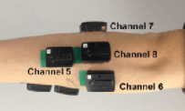
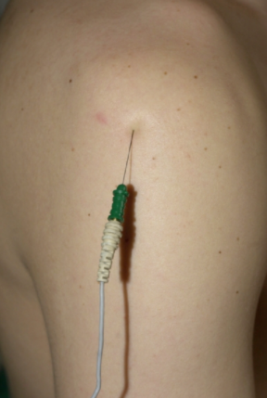
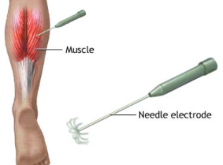
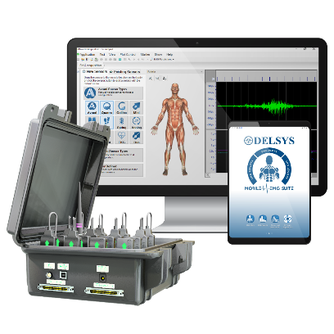
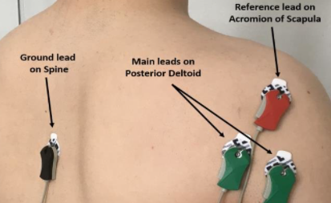
Commercial EMG systems are incompatible with spacesuits and EVA protocols
Current Industry standard EMG sensors are:
Bulky, expensive, and difficult to use
Depend on bulky and expensive communication systems
Invasive and uncomfortable
Not well adherent to skin (requires adhesive)

Slide 7
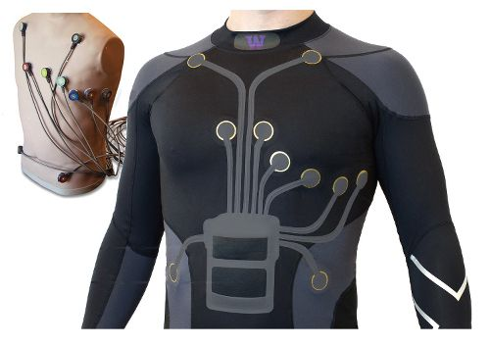
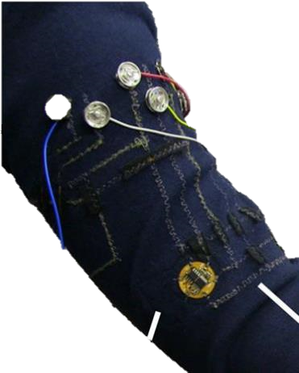
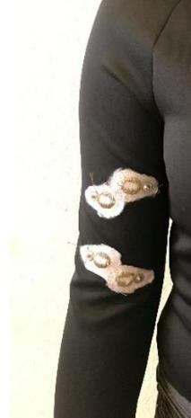
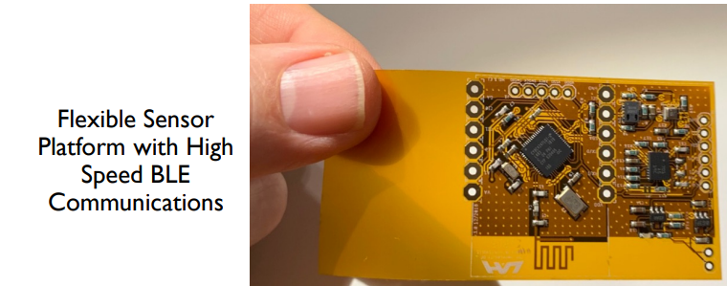
PROPOSAL: A spacesuit compatible EMG garment with flexible electronics
A comfortable, easy to use EMG garment
Self-positioning flexible electrodes
Machine learning software to detect fatigue
Radio communication to control wearable robots
Spacesuit/EVA compatible design
(Figure from [7])

Slide 8
References
Ramachandran, Vignesh et al. “Musculoskeletal Injuries in Astronauts: Review of Pre-flight, In-flight, Post-flight, and Extravehicular Activity Injuries.” Current Pathobiology Reports 6 (2018): 149-158.
Shields, B L et al. “An anthropomorphic hand exoskeleton to prevent astronaut hand fatigue during extravehicular activities.” IEEE transactions on systems, man, and cybernetics. (1997): 668-73.
Shafer, Benjamin A et al. “Neuromechanics and Energetics of Walking With an Ankle Exoskeleton Using Neuromuscular-Model Based Control: A Parameter Study.” Frontiers in bioengineering and biotechnology vol. 9 615358. 9 Apr. 2021
Abd-Elfattah, Hoda M et al. “Physical and cognitive consequences of fatigue: A review.” Journal of Advanced Research 6. (2015): 351-358
Can, Wang et. Al. “A Real-Time Stability Control Method Through sEMG Interface for Lower Extremity Rehabilitation Exoskeletons.” Frontiers in Neuroscience 15 (2021): 280
Vøllestad, Nina K et al., “Measurement of human muscle fatigue.” Journal of Neuroscience Methods 74 (1997): 219-227
Jovanov, E et al. “Long Term Monitoring of Respiration and CO2 using Flexible Printed Sensors” 2020 IEEE Aerospace Conference (2020): 1-10

